Slide 1




NUMERICAL CALCULUS
PRESENTED BY TEAM 6
Numerical Analysis

Slide 2







MEET
OUR TEAM
Eris Alfionita
(24083010032)
Alifah Zuhrah
(24083010033)
Elina putri
(24083010085)

Slide 3






Lesson Outline
Rudiments of Numerical Calculus
Undetermined Coefficients
Composite Integration

Slide 4





RUDIMENTS OF NUMERICAL CALCULUS
Numerical calculus studies how to compute derivatives and integrals using approximation, especially when a function is known only at discrete points.
Many real-world functions come from measurements, not formulas
Computers cannot evaluate limits directly. Numerical methods are needed

Slide 5






THE FUNDAMENTAL CONCEPT
Replace Limits with h
Derivative definition:
Computers cannot compute limits, because limits involve infinite processes.
Use a small but nonzero h:
This is the forward difference, the simplest numerical derivative.

Slide 6




PRACTICAL ISSUES IN NUMERICAL CALCULUS
1, EFFICIENCY
2. AUTOMATION
methods must be fast enough for real computation
algorithms must be easy for a computer to implement
3. ACCURACY
we must understand and control approximation errors

Slide 7
STENCILS
A stencil determines which points are used in a numerical approximation.
Different stencils produce different formulas and different accuracy levels.
examples :
Forward Difference :
Central Difference :
Backward Difference :
x --- x+h
x-h --- x+h
x-h --- x
# Central stencils are symmetric, which leads to higher accuracy.

Slide 8



FINITE DIFFERENCE APPROXIMATIONS
three basic formulas :
Forward Difference :
Backward Difference :
Central Difference :

Slide 9
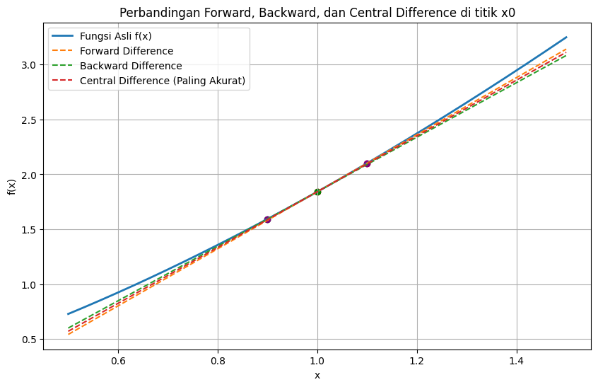
GRAFIK
Forward and backward differences deviate slightly because they use one-sided points.
The central difference line aligns more closely with the true function because it uses symmetric points around x. This demonstrates why central difference achieves higher accuracy.

Slide 10


INTERPOLATION
Numerical differentiation can be obtained by constructing an interpolating polynomial that passes through selected data points and then differentiating that polynomial.
Lagrange Interpolation Example
The interpolating polynomial for two points is:
The derivative approximation is obtained by:
The interpolating polynomial serves as a local approximation of the true function.
Differentiating the polynomial produces derivative formulas.
Different choices of stencil generate forward, backward, or central difference formulas.

Slide 11




NUMERICAL INTEGRATION
APPROXIMATE THE DEFINITE INTEGRAL :
RECTANGLE RULE
TRAPEZOIDAL RULE
SIMPSON’S RULE
THIS METHOD ASSUMES THE FUNCTION IS CONSTANT OVER THE INTERVAL,
RESULTING IN FIRST-ORDER ACCURACY (O(H)).
THE FUNCTION IS APPROXIMATED BY A STRAIGHT LINE BETWEEN TWO POINTS, GIVING SECOND-ORDER ACCURACY (O(H²)).
THIS RULE USES A QUADRATIC INTERPOLATION (PARABOLA) TO APPROXIMATE THE INTEGRAND, LEADING TO FOURTH-ORDER ACCURACY (O(H⁴)).

Slide 12







UNDETERMINED COEFFICIENTS
A Powerful Method for Deriving Numerical Formulas

Slide 13

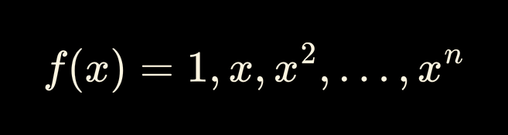

GOAL: DERIVE FORMULAS WITH MINIMAL ERROR
The Principle
The Method of Undetermined Coefficients is a straightforward technique to derive numerical formulas (for differentiation, integration, etc.) by forcing them to be exact for polynomials up to a certain degree.
The Core Idea
Assume the numerical approximation is a linear combination of function values at known points (nodes).
The coefficients in this linear combination are the "undetermined coefficients
We determine these coefficients by ensuring the formula holds true for

Slide 14
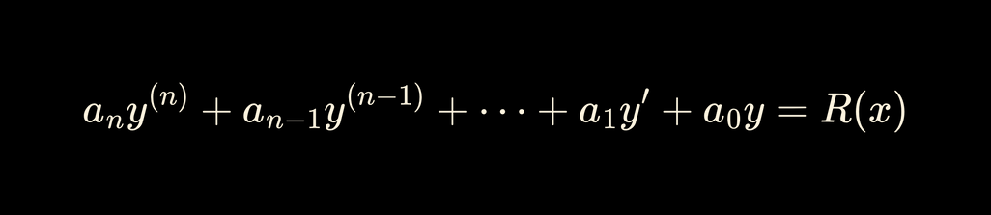
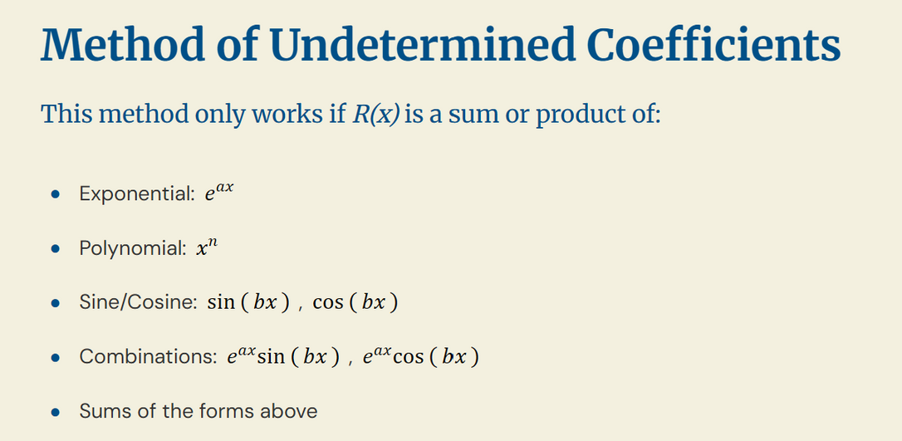
MAIN REQUIREMENTS OF THE UNCERTAIN COEFFICIENT METHOD
The equation must be LINEAR
Only valid for:
2. The coefficient must be CONSTANT
3. The form R(x) must be “standard”

Slide 15
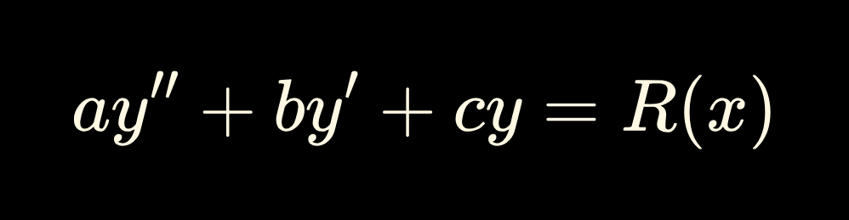
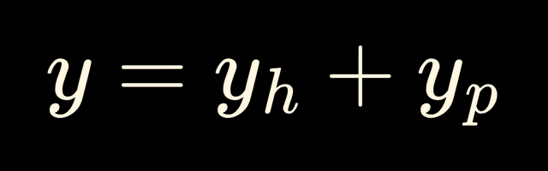


THE GENERAL EQUATION AND SOLUTION STRUCTURE
Where R(x) is the non-homogeneous function
GENERAL SOLUTION STRUCTURE (Y):
The general solution is the sum of the homogeneous solution
the particular solution

Slide 16
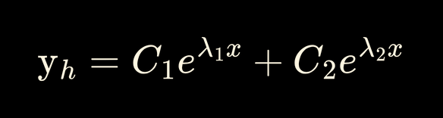
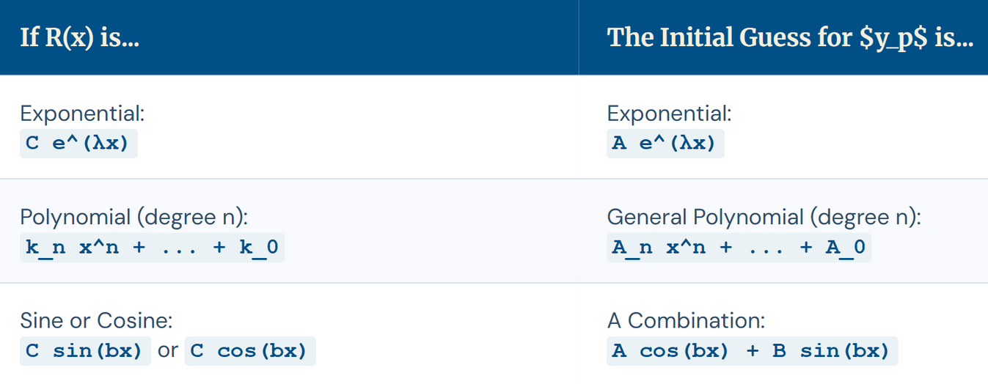
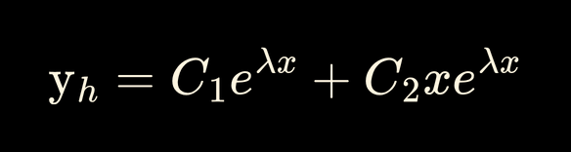
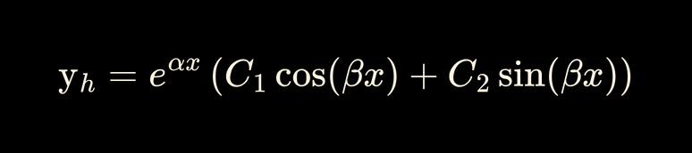

STEP PROCESS
Step 1: Finding the Homogeneous Solution
Step 2: Guessing the Particular Solution
The form of yp is based on the form of R(x). Use this table as a guide:
We solve the Characteristic Equation (PK):
Distinct Real Roots
2. Repeated Real Roots
3. Complex Roots
*The coefficients A, B, C, etc. are the undetermined constants that must be found by substituting back into the original DE.

Slide 17

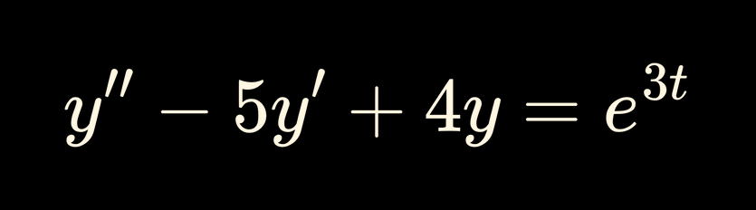
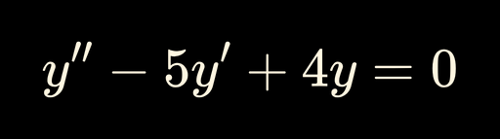
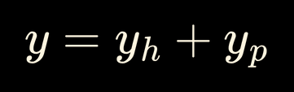


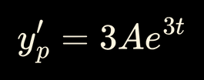
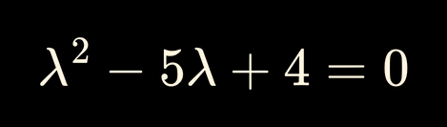
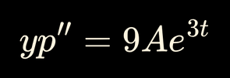
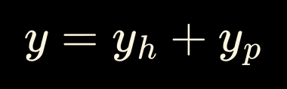
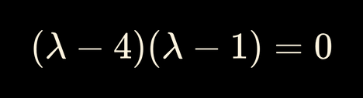
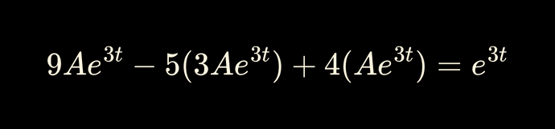
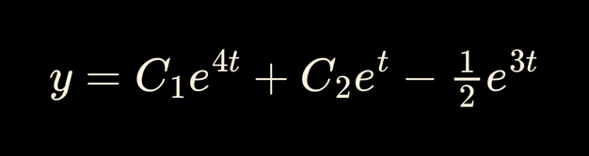
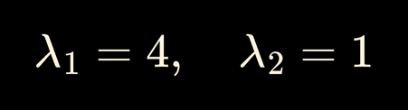
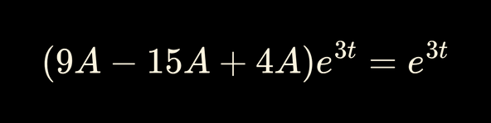





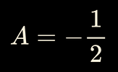

EXAMPLE
Finding
⇒ Substitution:

Slide 18
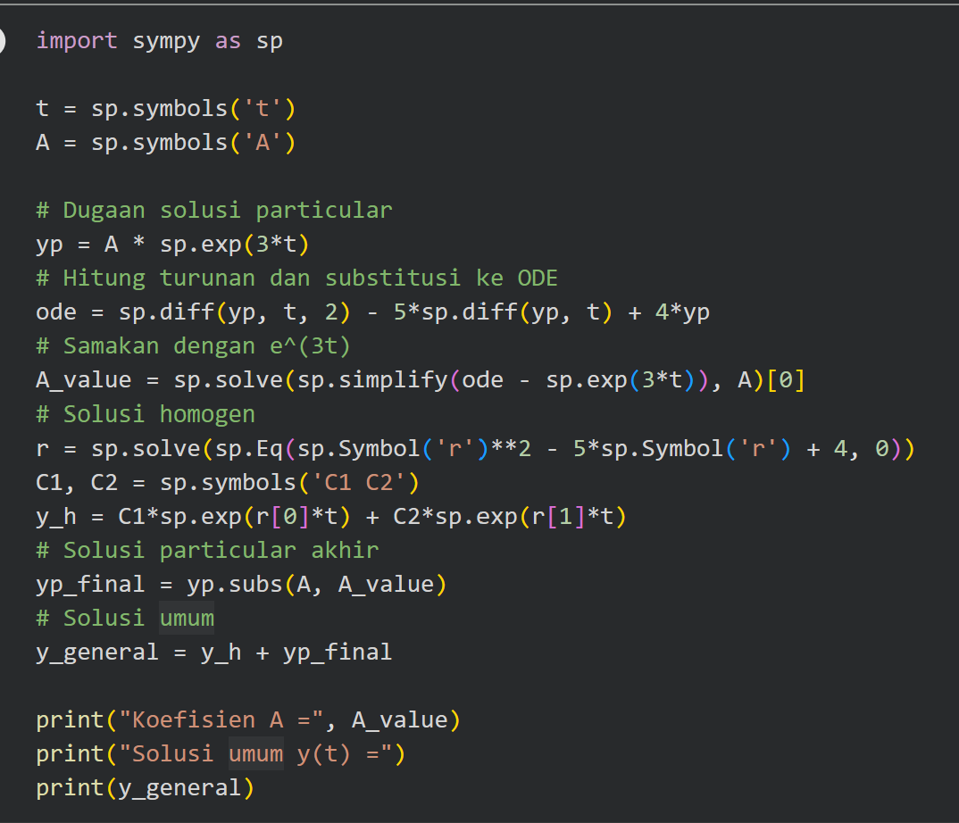
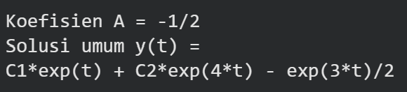

EXAMPLE
RESULT:

Slide 19






COMPOSITE INTEGRATION
PROBLEM
Simple integration formulas (like the Trapezoidal Rule) have an error term like
This seems great, but it's misleading. The quantity being approximated also depends on :

Slide 20





COMPOSITE INTEGRATION
DECOMPOSE
Divide the large interval [a, b] into n smaller, equal subintervals.
APPLY
Apply a simple integration rule to each small subinterval.
SUM
Sum the results from all subintervals to get the final approximation for the total integral

Slide 21






COMPOSITE TRAPEZOIDAL RULE
Summing the simple rule is inefficient. We can simplify it by combining terms.
simplified to
where
and

Slide 22













ERROR IN COMPOSITE RULES
SIMPLE RULE ERROR
COMPOSITE RULE ERROR
The error for a single interval
The new error term is
was
For Composite Trapezoidal,
For Trapezoidal,
so the error is
so the error is
This is the key: The error is now a function of (the number of subintervals). Doubling quarters the error!
This is misleading, as was the entire interval.

Slide 23
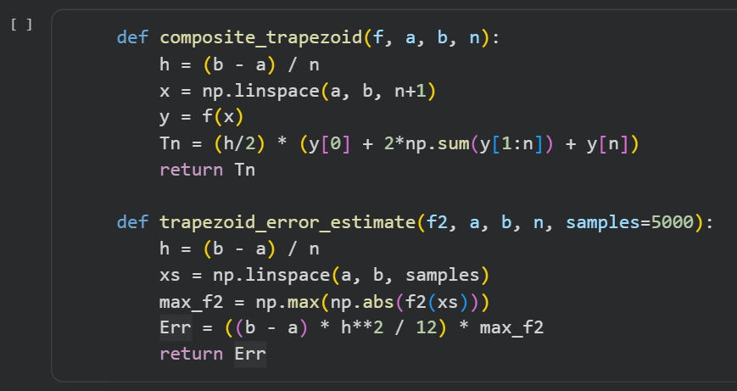
COMPOSITE TRAPEZOIDAL RULE
THE ALGORITHM

Slide 24




THANK YOU
For Your Attention

